Slide 1
Assessing Disparities in Pneumococcal Vaccine Service Delivery in the Rural Fee-for-Service Medicare Population
National Vaccine Advisory Committee
March 25, 2019
Jeffery Talbert, PhD
Patricia R. Freeman, PhD
Pharmacy Practice and Science
University of Kentucky
College of Pharmacy

Slide 2
Pneumococcal Disease
Significant public health concern in US, especially among elderly
Mortality from invasive pneumococcal disease ranges from 20% at 65 years of age to 40% at 85 years of age
CDC. Epidemiology and Prevention of Vaccine-Preventable Diseases (The Pink Book), 13th ed. Washington, DC: Public Health Foundation; 2015.

Slide 3
Pneumococcal Vaccination
2-dose vaccination series recommended for persons age$≥$65
1 dose PCV13 at age 65 and 1 dose PPSV23 at least 1 year later
Vaccination rates remain low
50% for either vaccine individually
<20% for 2-dose series
McLaughlin J et al. Disparities in Uptake of 13-valent Pneumococcal Conjugate Vaccine among Older Adults Following Routine Recommendation in the United States. Open Forum Infectious Diseases. 2017;4(Suppl 1):S468-S469. .

Slide 4
Disparities in Pneumococcal Vaccination
Racial and geographic disparities noted in previous research
Cause of disparities
Socioeconomic barriers?
Reduced access to clinic-based health care providers?
McLaughlin J et al. Disparities in Uptake of 13-valent Pneumococcal Conjugate Vaccine among Older Adults Following Routine Recommendation in the United States. Open Forum Infectious Diseases. 2017;4(Suppl 1):S468-S469.

Slide 5
Pharmacies as Alternate Sites
Use of alternate sites for vaccine delivery has been recommended to improve vaccine coverage
All 50 states and D.C. authorize pharmacists to provide pneumococcal vaccines
93% of Americans live within 5 miles of a community pharmacy
May play a significant role in vaccine access, especially in rural communities

Slide 6
Study Objectives
To evaluate trends in pneumococcal vaccination service delivery for the years 2012 -2015
To determine the relative contribution of community pharmacies as an alternate site vaccine service provider

Slide 7
Methods
Data Source: Medicare Physician and Other Supplier Public Use File, years 2012 to 2015
Pneumococcal vaccination services were identified by:
Providers were classified as: primary care provider, pharmacy provider, or other
HCPCS G0009 “any pneumococcal vaccine administered”
CPT 90670 “PCV13 administered”
CPT 90732 “PPSV23 administered”
Notes:
with 1-3 designated as urban, and 4-9 as rural ; variables from the medicare goegarphic variation county public use file included average age; average Hierarchical Condition Category (HCC) score, a composite risk score reflective of chronic disease burden; and percent male, white non-Hispanic, eligible for Medicaid, and using inpatient or outpatient services ;
Descriptive statistics on vaccine services by rural-urban designation, provider type, vaccine type, and year were calculated. A logistic regression model of the estimated rate of pneumococcal vaccination in 2015 was created using the parameters from the Medicare Geographic Variation table, rural-urban designation, the percent of vaccines provided by pharmacists, and the interaction of rural-urban designation with percent of vaccines provided by pharmacists

Slide 8
Methods
Urban status was identified by provider NPI registration address linked to Rural-Urban Continuum Codes
County level demographics were incorporated from the Medicare Geographic Variation Sate/County Public Use File
Descriptive statistics were performed for vaccine services by rural-urban designation, provider, vaccine type, and year
Logistic regression was performed predicting likelihood of pneumococcal vaccination in 2015
Notes:
with 1-3 designated as urban, and 4-9 as rural ; variables from the medicare goegarphic variation county public use file included average age; average Hierarchical Condition Category (HCC) score, a composite risk score reflective of chronic disease burden; and percent male, white non-Hispanic, eligible for Medicaid, and using inpatient or outpatient services ;
Descriptive statistics on vaccine services by rural-urban designation, provider type, vaccine type, and year were calculated. A logistic regression model of the estimated rate of pneumococcal vaccination in 2015 was created using the parameters from the Medicare Geographic Variation table, rural-urban designation, the percent of vaccines provided by pharmacists, and the interaction of rural-urban designation with percent of vaccines provided by pharmacists

Slide 9
Findings

Slide 10
Total Number of PPSV23 and PCV13 Vaccination Services, in Thousands, 2012-2015
Year | PPSV23 | PCV13
2012 | 1,067 (97.7%) | 25 (2.3%)
2013 | 1,077 (92.3%) | 90 (7.7%)
2014 | 1,025 (66.9%) | 507 (33.1%)
2015 | 445 (8.4%) | 4,852 (91.6%)
Notes:
This table depicts the number of pnueomocoll vaccinations ervices for the two types of vaccines, over the 4 years int hes tudy period. 5.35 million beneficiaires (16% of eligible) received pneumo vaccine in 2015 and Alsomst 4-fold increase in number of pneumococcal vaccines provided to FFS benefidicars between 2012 and 2015 and as you can see is driven by the uptake of PCV13.

Slide 11
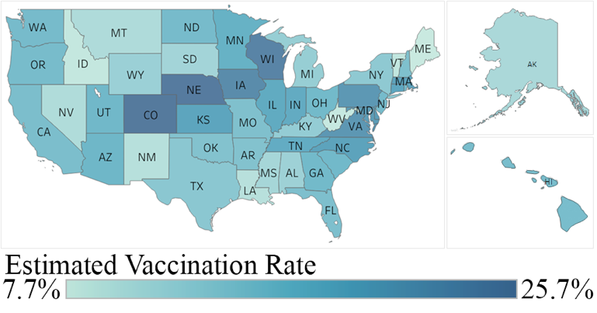
Rate of Pneumococcal Vaccine Service Delivery per Eligible Population, 2015
Notes:
Rates of vaccine service delivery varies significantly across the country. Form a low of 7.7% in Maine to a high of 25.7% in CO.
Significant rural urban disparities noted. - 10.7% rate in rural vs 17.4% in urban communities.

Slide 12
Number of Pneumococcal Vaccination Services by Provider Type and Rural-Urban Designation, in Thousands, 2015
Provider Type | Rural Vaccination Services |  | Urban Vaccination Services |  | Combined Vaccination Services
Pharmacy | 247 | (33.5%) | 1,049 | (22.7%) | 1,296 | (24.2%)
Primary Care | 465 | (63.1%) | 3,398 | (73.6%) | 3,863 | (72.2%)
Other | 25 | (3.4%) | 168 | (3.6%) | 193 | (3.6%)
Total | 737 |  | 4,615 |  | 5,353 | (100%)
Notes:
In 2015, primary care providers delivered the majority (72.2%) of pneumococcal vaccination services to FFS Medicare beneficiaries while pharmacy providers accounted for one-fourth. In rural communities, pharmacy providers delivered one-third of pneumococcal vaccine services, suggesting the important role of rural pharmacies in vaccine access.

Slide 13
Percent of Pneumococcal Vaccination Services Delivered by Provider Type and Rural-Urban Designation, 2012 to 2015
Notes:
When look at the trends over time separated by rural/urban can see the increasingly important role that pharmacy provdiers are playing in vaccine delivery

Slide 14
Summary of Model Results
Variables positively associated with vaccination
Increasing age of beneficiaries
Greater proportion of female beneficiaries
Greater proportion of white non-Hispanic beneficiaries
Variables negatively associated with vaccination
Rurality
Lower overall health status
Greater use of outpatient services vs inpatient services
Significant interaction
Between rurality and percent of vaccines provided by pharmacists
Notes:
The interaction between rurality and percent of vaccines provided by pharmacists was significant and when interpreted with the finding from Figure 1 that pharmacists provide a greater proportion of vaccines in rural versus urban areas, suggests that community pharmacies play an important role in access to pneumococcal vaccinations in rural areas

Slide 15
Summary of Key Findings
Between 2014 and 2015, pneumococcal vaccine services delivered to FFS Medicare beneficiaries increased by 380%
Continued disparities in delivery of pneumococcal vaccine services to FFS Medicare beneficiaries in rural and urban communities are noted, with a 63% higher vaccination rate observed in urban areas

Slide 16
Summary of Key Findings
Primary care providers delivered the majority of pneumococcal vaccine services
Pharmacy providers, overall, deliver one-fourth of pneumococcal vaccine services
Pharmacy providers in rural communities play an increasing role in pneumococcal vaccine service delivery

Slide 17
Conclusion and Recommendations
Disparities in pneumococcal vaccination rates between rural and urban areas are noted
Community pharmacies serve as important access points for pneumococcal vaccine services in rural communities
Continued support of rural service providers is needed to ensure older adults have access to recommended vaccines

Slide 18
Research Team
Joseph Vanghelof, PharmD, MS
Aric Schadler, MS

Slide 19
Acknowledgement
This project was supported by the Federal Office of Rural Health Policy (FORHP), Health Resources and Services Administration (HRSA), U.S. Department of Health and Human Services (HHS) under cooperative agreement # U1CRH30041.
The information, conclusions and opinions expressed in this document are those of the authors and no endorsement by FORHP, HRSA, HHS, or the University of Kentucky is intended or should be inferred.

